Slide 1

Application-Level
Fault Tolerance for Embedded Real-Time Systems
Israel Koren
Department of Electrical & Computer Engineering
University of Massachusetts
Amherst, MA, 01003
Supported in part by DARPA, NASA/JPL and NSF

Slide 2
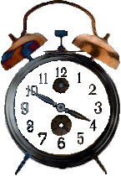
Introduction
Fault Tolerance can be incorporated at two levels:
  System Level: encompasses all types of redundancy of system HW and SW components and recovery actions taken by the system (application independent)
  Application level: encompasses redundancy and recovery actions within the application software itself
For general-purpose systems the first is preferable
For large-scale real-time applications system-level fault tolerance alone is too expensive and may be insufficient
  Massive hardware and/or software redundancy is usually too expensive for embedded systems
  Recovery overhead associated with movement of large process checkpoints increases the chances of missing a deadline
<number> of 38
UMass - Architecture and Real-Time Systems Lab

Slide 3
Application-Level Fault Tolerance (ALFT)
Key Idea: Exploit application semantics to implement low overhead fault tolerance
Redundancy can be tuned to the extent of fault-tolerance required - scalable fault-tolerance
  Allowing more overhead for ALFT produces higher quality results
  Trade off fault- tolerance against computation overhead
Application-Level Fault Tolerance (ALFT) can complement existing system- or algorithm-level fault-tolerance by leveraging information available only at the application level
We have integrated our ALFT techniques with four large-scale real-time applications from Honeywell and NASA
UMass - Architecture and Real-Time Systems Lab
<number> of 38

Slide 4
ALFT - General Approach
Each processor performs, in addition to its own work (P,primary) , a scaled-down copy of its neighbor's work (S,secondary)
Upon detecting a faulty neighbor, the node provides its secondary results as substitution
Node 1
P₁
S₄
Node 2
P₂
S₁
Node 3
P₃
S₂
Node 4
P₄
S₃
Fault
When recovered, the interrupted process begins calculations with data which its secondary has computed on its behalf
<number> of 38
UMass - Architecture and Real-Time Systems Lab

Slide 5
Issues to be resolved
How to scale down the secondary?
  Precision vs. overhead
Should we always run the secondaries?
The answers are application dependent
<number> of 38
UMass - Architecture and Real-Time Systems Lab

Slide 6
Benchmark Applications
Real-Time applications used for benchmarking:
Applications from Honeywell
  RTHT (real-time hypothesis tracking)
  ABF (adaptive beam forming)
Applications from NASA’s REE suite
  OTIS (orbital thermal imaging spectrometer)
  NGST (next generation space telescope)
<number> of 38
UMass - Architecture and Real-Time Systems Lab

Slide 7
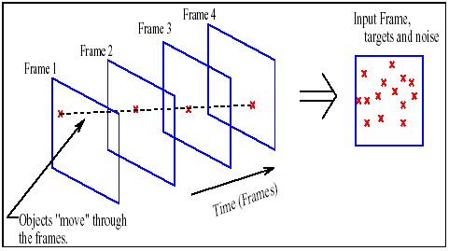
The RTHT Application
Real-Time Hypothesis Tracking: tracks objects moving about in a 2-D coordinate plane (using data from radar), to distinguish between real targets and noise clutter
<number> of 38
UMass - architecture and Real-Time Systems Lab

Slide 8
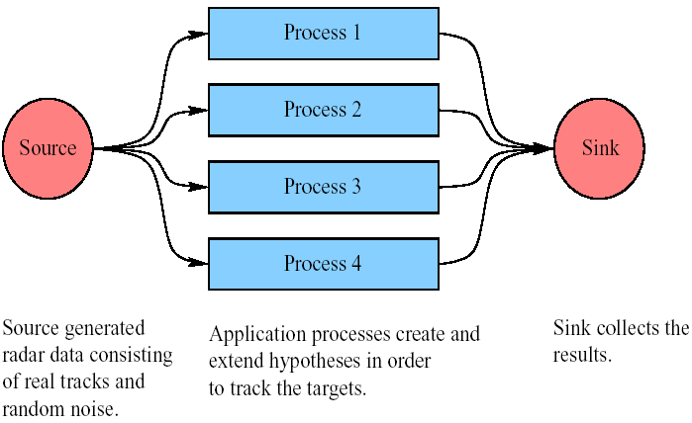
RTHT Processes
Each process tracks targets through the creation and extension of hypotheses which include a figure of likelihood
When a target object makes it through more and more consecutive frames, its hypothesized track becomes more likely to be real
<number> of 38
Umass - Architecture and Real-Time Systems Lab

Slide 9
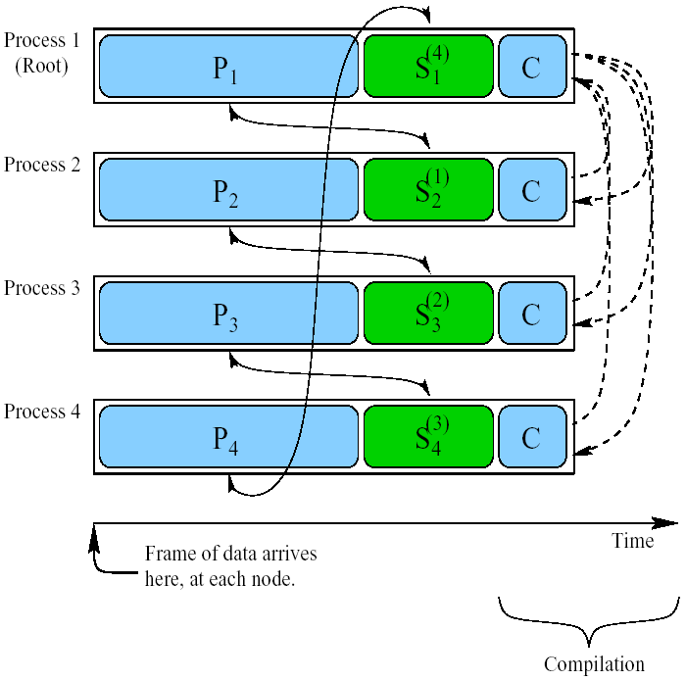
RTHT with ALFT
Secondary extends the top p% of hypotheses
Without the secondary a Cold-Start would be required if the node recovers but does not take part in the compilation
<number> of 38
Umass - Architecture and Real-Time Systems Lab

Slide 10
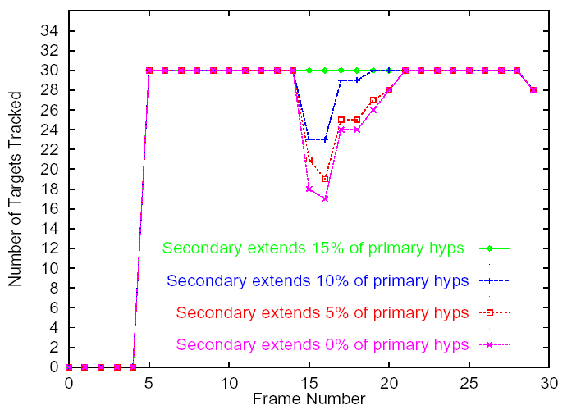
RTHT Results
Number of Targets Tracked
30 real targets, 80 false alarms and two application processes
A single fault, lasting one frame, occurs at Frame No. 15
With a redundancy of just 15%, we can track all the real targets, despite the faulty node
<number> of 38
Umass - Architecture and Real-Time Systems Lab

Slide 11
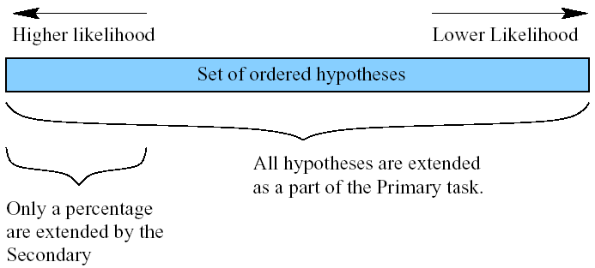
Why only 15%?
Hypotheses are sorted in order of likelihood
The hypotheses extended by the secondary are the ones most likely to be real targets
Umass - Architecture and Real-Time Systems Lab
<number> of 38

Slide 12
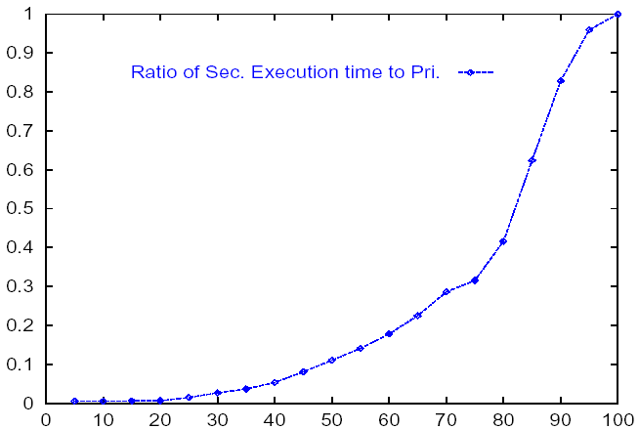
Secondary time overhead
Ratio of Secondary Execution Time to Primary
Percentage of Secondary Overlap
An even smaller computational load is imposed by the secondary
The extension of hypotheses that are most likely to be real, takes less time
Umass - Architecture and Real-Time Systems Lab
<number> of 38

Slide 13
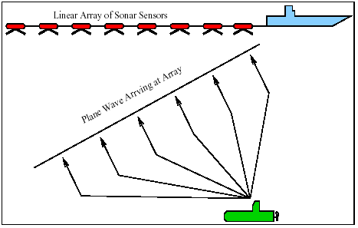
The ABF Application
Linear Array of Sonar Sensors
Plane wave arriving at array
The Adaptive Beam Forming Application detects sound as it impinges on a linear array of sonar sensors
Umass - Architecture and Real-Time Systems Lab
<number> of 38

Slide 14
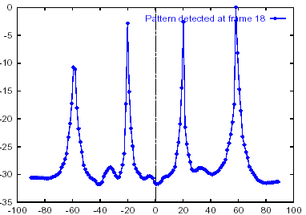
ABF Processes
Magnitude (db)
Direction (angle) of arrival (degrees)
Each process works on a distinct subset of frequency range, and dynamically updates a set of weights every frame
A beam that emphasizes the sound coming from each direction is formed using these weights
<number> of 38
Umass - Architecture and Real-Time Systems Lab

Slide 15
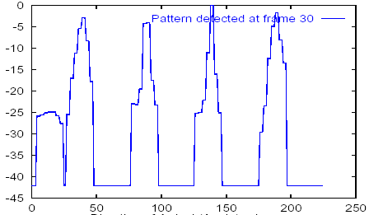
ABF with ALFT
Two methods of secondary reduction:
  Limited Field of View : search only in certain directions (windows)
  Reduced Granularity : search full field at lower granularity
A blend of the two methods
Example Output: Combined Techniques
Magnitude (dB)
Direction of Arrival (Angle) - Degrees
<number> of 38

Slide 16
ABF Results
Redundancy Technique
Secondary Overlap
Computational Overhead
Reduced Granularity
33%
35%
Limited FOV
30%
30%
Combined - 30% FOV and 50% Granularity
15%
17%
Four beams of sound at 32 frequency ranges
Two application processes
A single node failure in Frame 20
Table shows minimum redundancy required to not lose track of any beam
Combining the two techniques reduces the computational overhead, while maintaining similar results
Umass - Architecture and Real-Time Systems Lab
<number> of 38

Slide 17
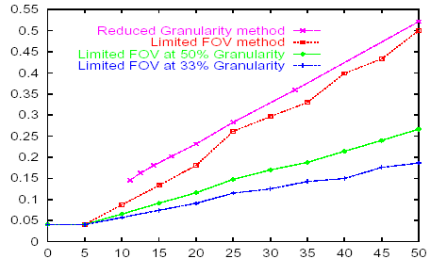
ABF - Secondary Overhead
Ratio of Sec. Execution Time to Primary
Percentage of Secondary Overlap
The computational load curves are linear (unlike RTHT) due to uniform dataset priority
Still, a reasonably small amount of extra computation is necessary to mask the fault
<number> of 38
Umass - Architecture and Real-Time Systems Lab

Slide 18
Adding Fault Detection
Faults do not always completely disable a node
  Malformed and corrupted data are more likely
Hardware-disabling faults are easy to detect with watchdog hardware and “I am alive” messages
  Faulty data is difficult to detect without application syntax
Fault detection is a necessary condition for ALFT to schedule which secondary tasks to run
Adding fault detection: employ acceptance filters to validate the primary’s output
Secondary tasks can provide verification for ambiguous (possibly faulty) data
Umass - Architecture and Real-Time Systems Lab
<number> of 38

Slide 19
Validation Through Secondaries
The “better” data is chosen according to the following logic grid:
Primary
Faultless
Ambiguous
Faulty
Run Secondary
Secondary
Faultless
Primary
Secondary
Secondary
Ambiguous
Primary
Primary
Secondary
Faulty
Primary
Primary
Primary*
<number> of 38
Umass - Architecture and Real-Time Systems Lab

Slide 20
Acceptance Filters
Filter 1
Filter 2
Data is OK
Results from
Primary
Pass
Fail
Secondary Task Queue
Faults are detected by passing results through one or more acceptance filters
  Filters are unique to applications with certain data characteristics
  Value bound tests are applicable to most applications
  Sanity check tests require knowledge of the expected output behavior and format
Umass - Architecture and Real-Time Systems Lab
<number> of 38

Slide 21
OTIS Characteristics
ALFTD was applied to OTIS (Orbital Thermal Imaging Spectrometer) - part of the REE suite
  OTIS reads radiation values from various bands and calculates temperature data
Useful characteristics of OTIS’ output (temperature)
  Local Correlation: Data changes gradually over an area
  Absolute Bounds: Data falls within some expected realistic range
<number> of 38
UMass - Architecture and Real-Time Systems Lab

Slide 22
ALFTD Filters for OTIS
Local Correlation and Absolute Bounds on the data led to the creation of two filters:
  Spatial Locality Filter: If the difference between pixel (x,y) and (x-1,y) is greater than some threshold α - the pixel may be the result of faulty data
  Absolute Bounds Filter: Any pixel not falling in the value range of ω < value < Ω may be the result of faulty data
  The filter thresholds (α, ω, Ω) are set based on sample datasets
<number> of 38
UMass - Architecture and Real-Time Systems Lab

Slide 23
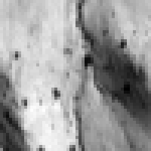
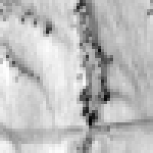
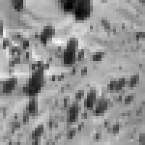
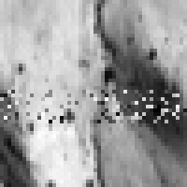
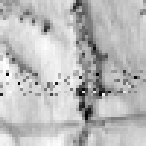
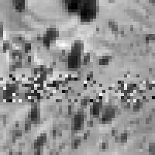
OTIS Datasets
Fault-free
“Blob”
“Stripe”
“Spots”
Faulty
<number> of 38
UMass - Architecture and Real-Time Systems Lab

Slide 24
Filter Calibration
ALFTD filters require calibration
  Higher detection probability with low rate of false alarms can be achieved with well-tuned filters
Calibration should be based on characteristics of the most frequent data
<number> of 38
UMass - Architecture and Real-Time Systems Lab

Slide 25
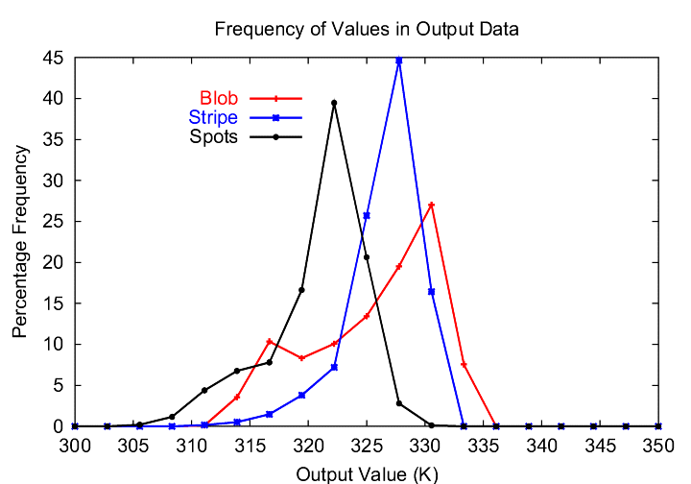
Frequency Plots (Bounds Filter)
Frequency of temperature values
<number> of 38

Slide 26
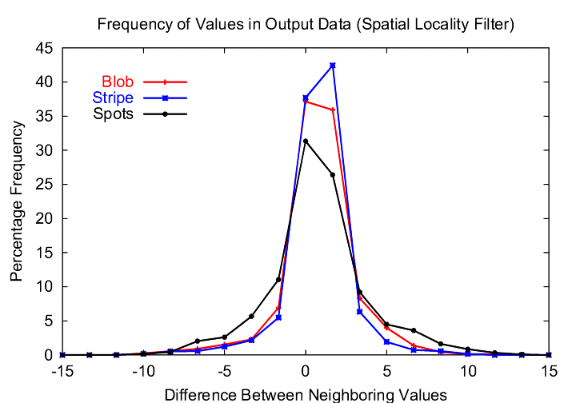
Frequency Plots (Spatial Locality Filter)
Frequency of differences between adjacent pixels
<number> of 38

Slide 27
Fault Injection
To test the detection capability we compared the fault-free output to an erroneous output - generated using fault injection
  Faults produce different kinds and intensities of errors
    Intensely faulty data (set-to-zero errors, memory gibberish) is easily detected, as it seldom falls inside the prescribed filters
    “Lightly” faulty data will not be detected but is negligible
    Our experiments include moderately faulty data: offsets in value of up to 30%
    These faults tend to blend in with non-faulty data, making them especially hard to detect
<number> of 38
UMass - Architecture and Real-Time Systems Lab

Slide 28
Filter Adjustment
Filters can be adjusted in steps
  A single filter has a high (“right”) and low (“left”) cutoffs
  The “left” and “right” bounds of data are usually exclusive, therefore their detections act cumulatively
For each filter - a tradeoff between the desired fault detection rate and the number of false alarms
Multiple filters are independently calibrated
  Multiple filters may detect more faults than a single filter and have a lower false alarms rate
  But - the subsets of faults detected will not necessarily be disjoint
<number> of 38
UMass - Architecture and Real-Time Systems Lab

Slide 29
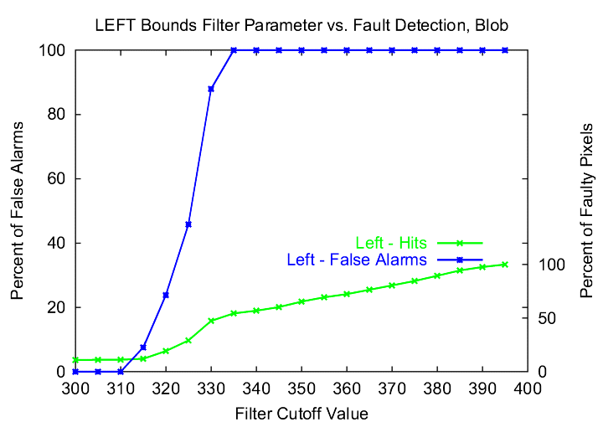
Detection Plots (Single Side)
Fault detections and false alarms for the left cutoff (“Blob”)
<number> of 38

Slide 30
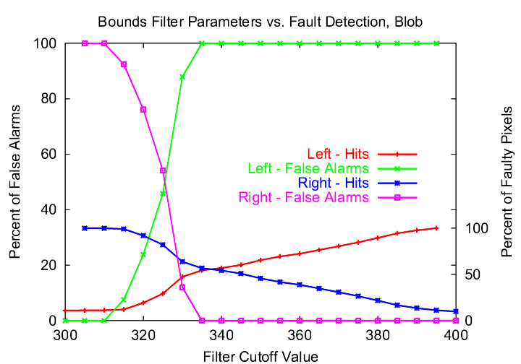
Detection Plots (Both Sides)
Overlaying the left and right filter cutoff plots - the impacts of the right and left cutoff values are asymmetric (“Blob”)
<number> of 38

Slide 31

Fault Detections, Numerically
Bounds Filter: Fault Detections
Columns = left cutoff, Rows = right cutoff
This table is used to find the possible configurations that satisfy a minimum required fault detection rate (80%)
<number> of 38
UMass - Architecture and Real-Time Systems Lab

Slide 32

False Alarms, Numerically
Bounds Filter: False Alarms
Columns = left cutoff, Rows = right cutoff
Of the possible combinations chosen from the previous table, choose the one with the minimum number of false alarms
<number> of 38
UMass - Architecture and Real-Time Systems Lab

Slide 33

Multiple Filters
By combining multiple filters, fault detection is improved
Bounds filter
Spatial Locality
filter
False Alarm → run secondary unnecessarily
<number> of 38
UMass - Architecture and Real-Time Systems Lab

Slide 34
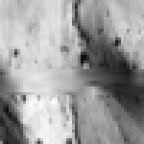
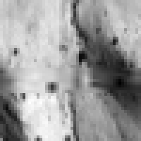
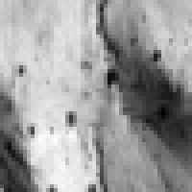
ALFTD-corrected output (“Blob”)
Fault-Free Output
Faulty Output
ALFTD- corrected Output
25% Overhead
33% Overhead
50% Overhead
<number> of 38

Slide 35




Difference Plots (“Blob”)
Faulty output versus fault-free output
Faulty
25% Overhead
33% Overhead
50% Overhead
No Error
Max Error
<number> of 38
UMass - Architecture and Real-Time Systems Lab

Slide 36
Conclusions
A high degree of fault tolerance at a minimal investment of system resources
Particularly useful in applications exhibiting data parallelism and some level of data redundancy or correlation
Scalable fault-tolerance
Attractive alternative to more expensive schemes such as hardware and/or software redundancy
Can complement system-level fault tolerance schemes
<number> of 38
UMass - Architecture and Real-Time Systems Lab

Slide 37
References
J. Haines, V.R. Lakamraju, I. Koren and C.M. Krishna, “Development of Application-Level Fault Tolerance in a Real-Time Benchmark," Proc. of EFTS'98, IEEE Workshop On Embedded Fault-Tolerant Systems, May 1998.
J. Haines, V.R. Lakamraju, I. Koren and C.M. Krishna, “Application- Level Fault Tolerance as a Complement to System-Level Fault Tolerance," The Journal of Supercomputing, Special Issue on “Embedded Fault-Tolerant Computing Systems,” Vol. 16, pp. 53-68, Kluwer Academic Publishers, MA, 2000.
E. Ciocca, I. Koren, C.M. Krishna, “Determining Acceptance Tests for Application-Level Fault Detection,” Proc. of the 2nd ASPLOS Workshop on Evaluating and Architecting System Dependability, pp. 47-53, Oct. 2002.
<number> of 38
UMass - Architecture and Real-Time Systems Lab

Slide 38

Thank You!
C.M. Krishna
Vijay Lakamraju
Josh Haines
Eric Ciocca
<number> of 38

Slide 39
Further Extension (Input Errors)
Real-time applications exposed to extreme environments can be affected by charged particles like alpha/cosmic rays
  High likelihood of input data faults manifesting as bit flips
Re-running the process or its secondary is useless as the input remains the same
Input data should be preprocessed to detect input errors and attempt to correct them
We have integrated preprocessing of input data in two NASA applications - OTIS and NGST
<number> of 38
UMass - Architecture and Real-Time Systems Lab

Slide 40
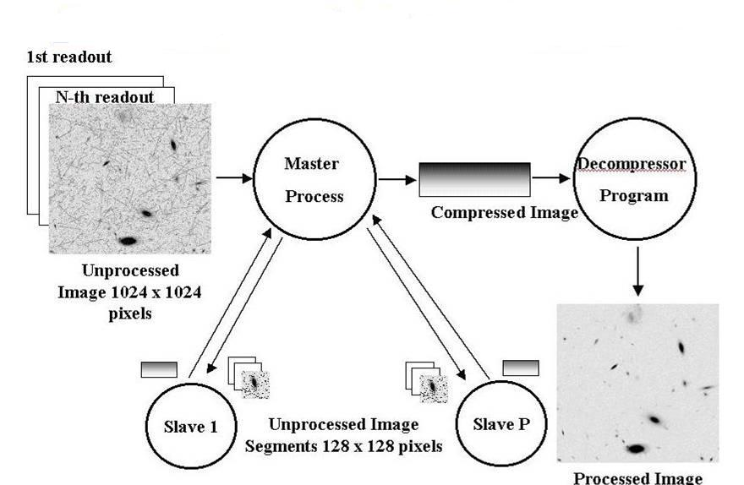
Next Generation Space Telescope
Space Station
Ground Station
Multiple readouts during each period
Use this redundancy to identify and recover from input data bit errors
Algorithms like optimal median smoothing and sliding-window bit majority smoothing can be used
<number> of 38
UMass - Architecture and Real-Time Systems Lab

Slide 41
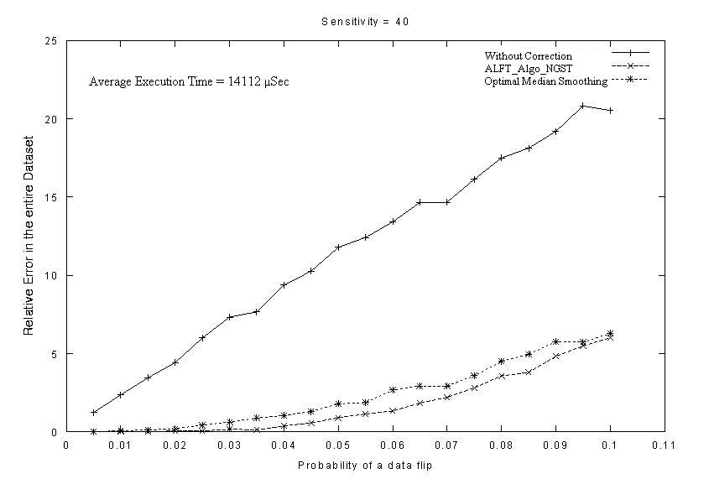
NGST - Results
Relative Error (entire dataset)
Probability of a data bit flip
<number> of 38
UMass - Architecture and Real-Time Systems Lab

Slide 42
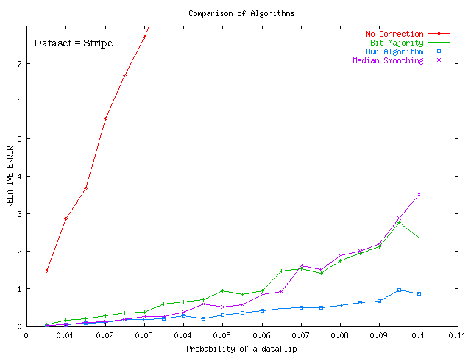
Results for OTIS
Relative Error
Probability of a data bit flip
Data redundancy in OTIS: multiple radiation mappings – one for each wavelength out of 128
Thermal data exhibits strong spatial locality and tight natural bounds can also be exploited by the preprocessing
<number> of 38
UMass - Architecture and Real-Time Systems Lab

